Slide 1
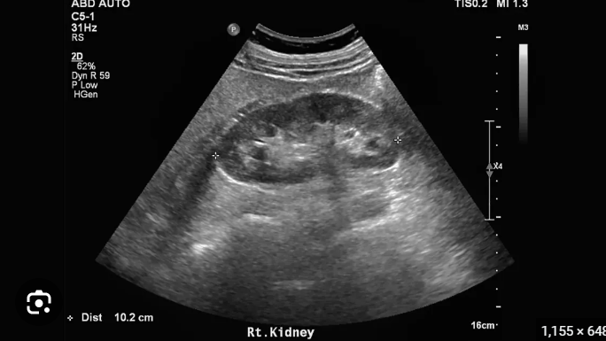
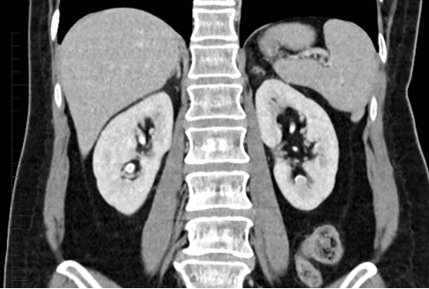
Methods for detecting kidney stones
Lab tests
Urinalysis
Blood tests.
Imaging tests
Abdominal x-ray
Computed tomography (CT) scans
Abdominal ultrasound

